Slide 1

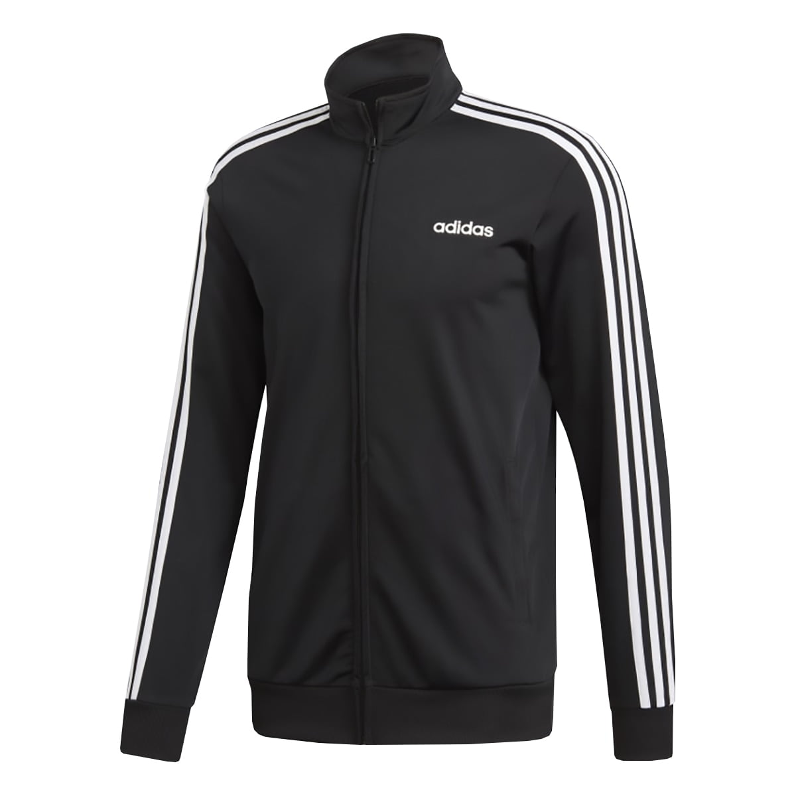
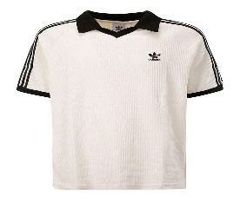
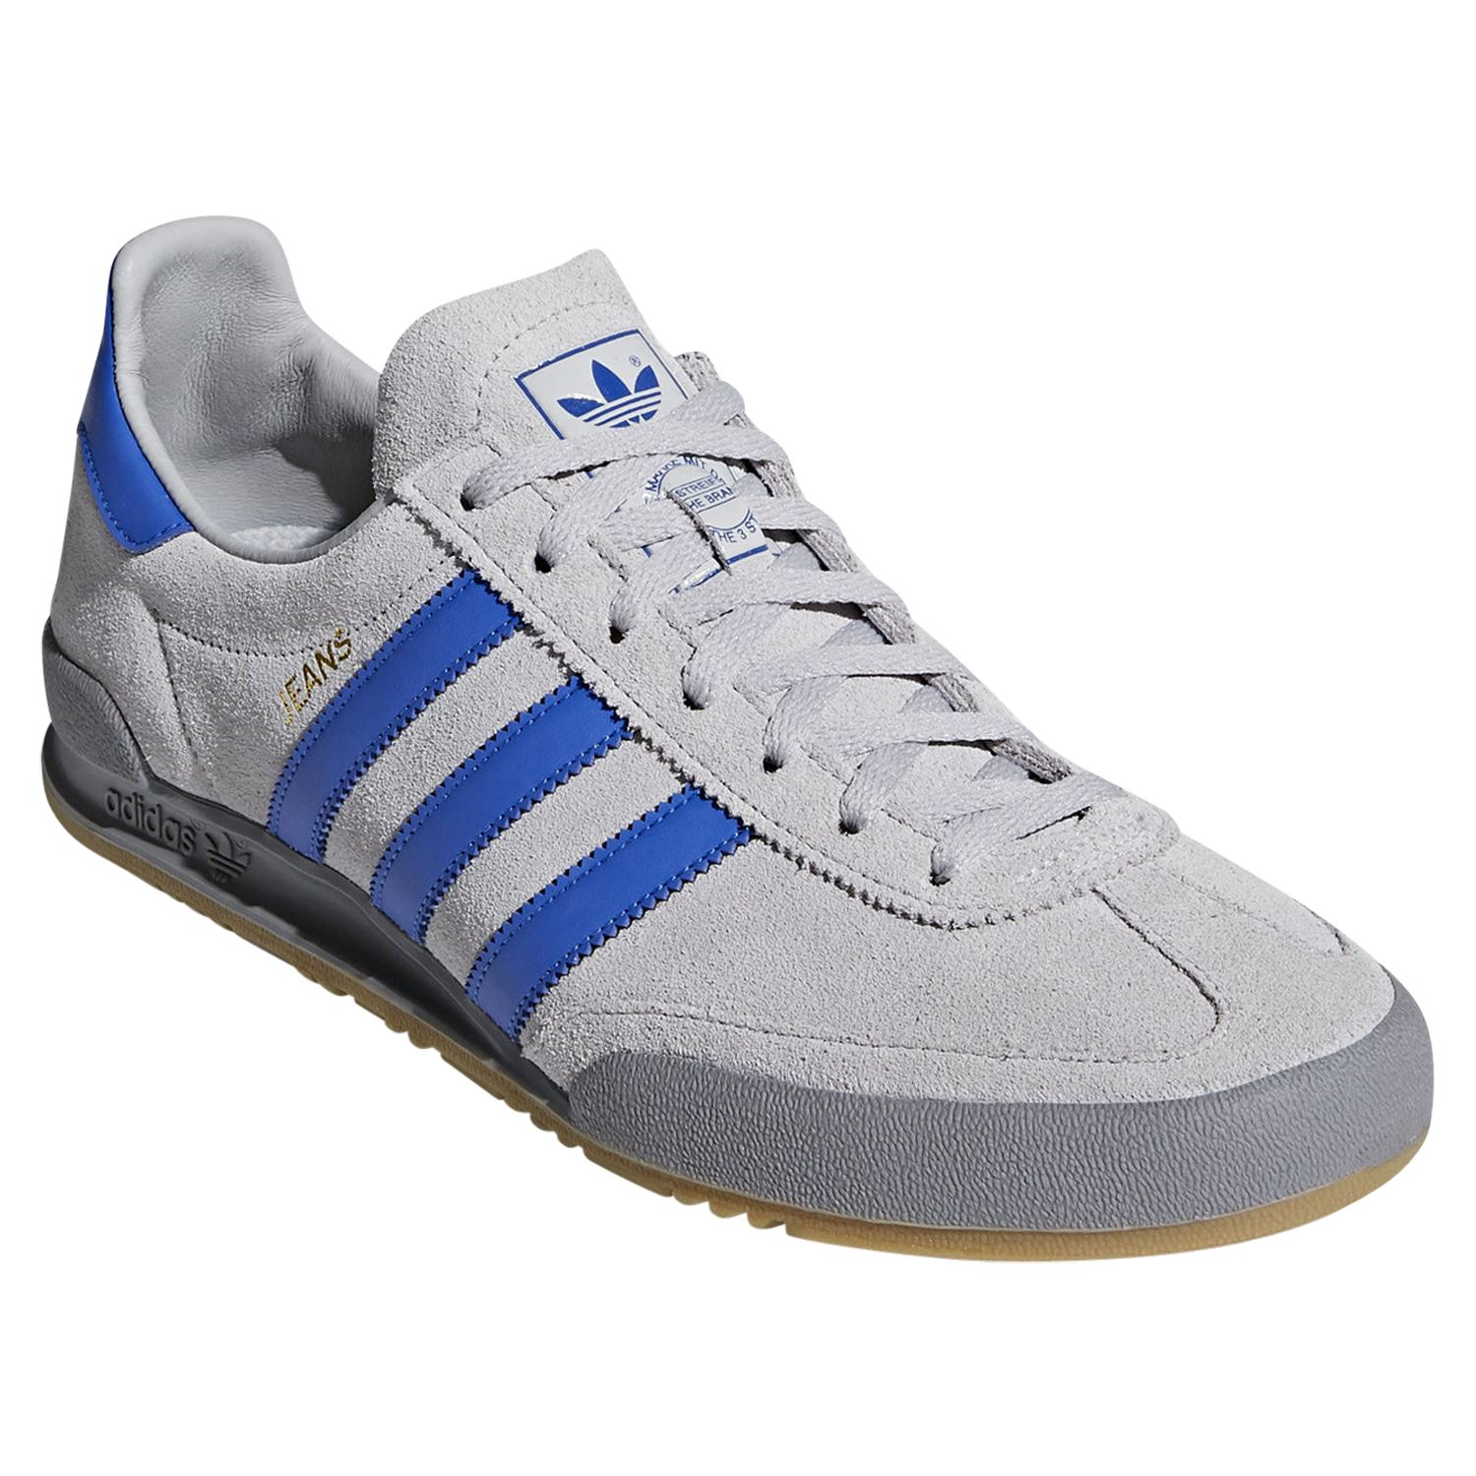
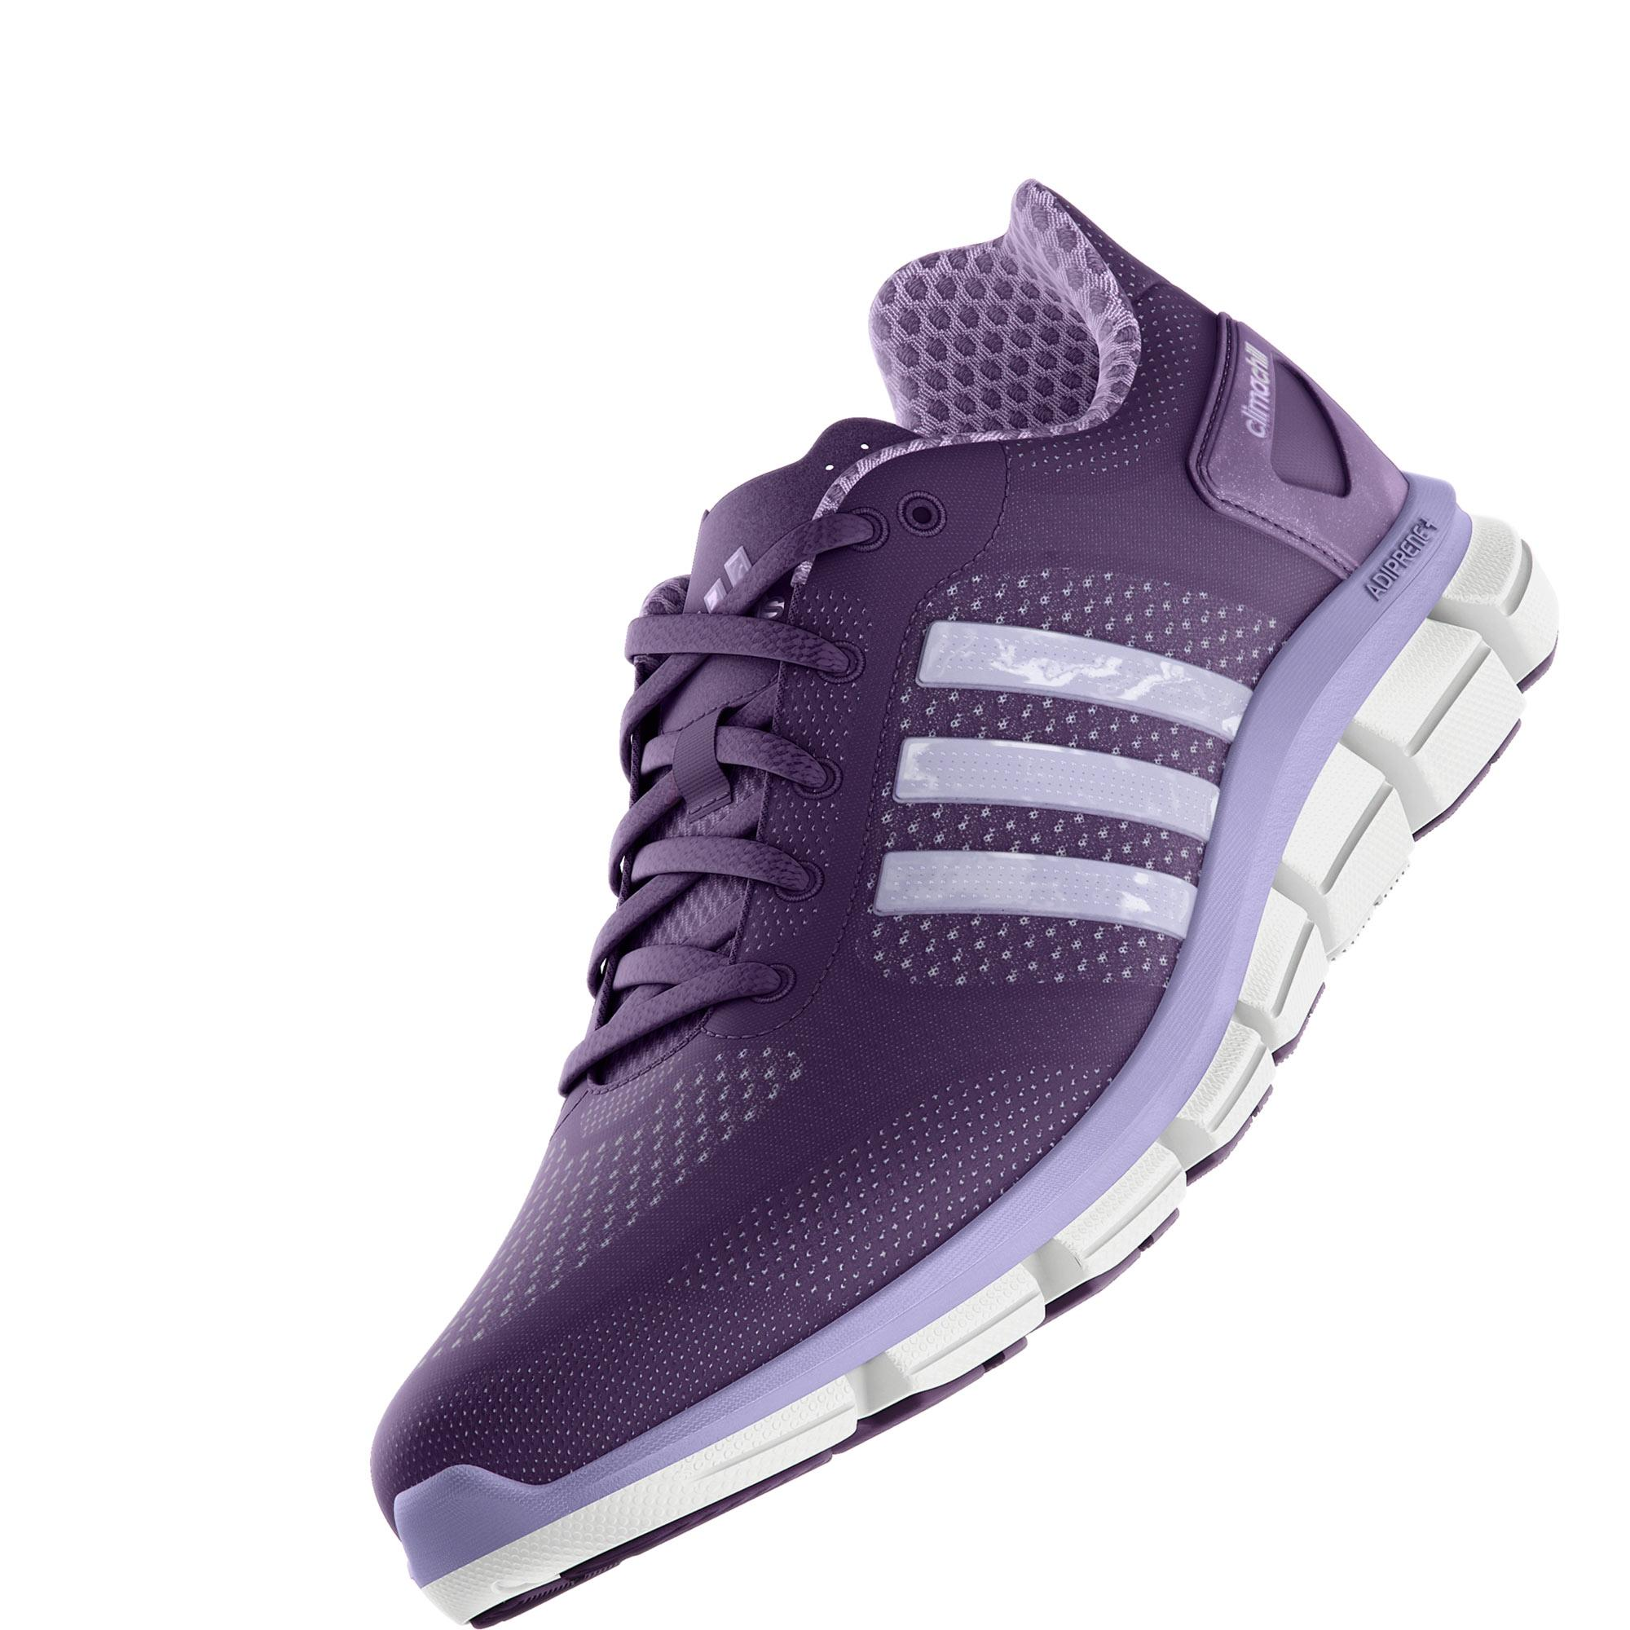
ADIDAS U.S SALES
DATA ANALYSIS
Presented by – Syed Afaq Ahmed

Slide 2
BUSINESS OVERVIEW
The data set is of Adidas business across United States for the years 2020 & 2021. It has spread its business across Midwest, Northeast, South, Southeast & West in United States selling products of categories such as men’s & women’s – street footware, athletic footware and apparels. It’s retailers are Amazon, Footlocker, Kohl’s, Sports Direct, Walmart and West Gear.

Slide 3
TOOLS USED
EXCEL

Slide 4
STEPS FOLLOWED
Looked for anomalies in data, Analysed the data (columns, categories of products, retailers, years)
Created pivot tables necessary for visualisations
Out of pivot tables, charts were created
All the charts and slicers were organised and formatted
Calculated Average Operating Margin, Total Revenue, Total operating expenses and Operating Profit Ratio

Slide 5
FINDINGS

Slide 6
Total Sales (in units) = 26,99,43,182
Total Revenue (in $) = 12,01,66,650
Total Operating Profit (in $) = 8,96,09,407
Total Operating Expenses = 3,05,57,243
Total Operating Profits account for 74.5% in Total Revenue

Slide 7
Total Sales and Average Operating Margin showed a notable increase in 2021.
Over the two-year period, a clear pattern emerged: sales consistently rose during the 3rd quarter but experienced a decline in the 4th quarter.

Slide 8
The Midwest and West regions exhibit a similar contribution of sales methods to operating profit.
The Northeast region shows a strong preference for in-store purchases, with minimal engagement
in online shopping.
In the South and Southeast regions, customers demonstrate a balanced trend, with significant
purchases made both in outlets and online.

Slide 9
Retailers -
In the Northeast region, Amazon, Foot Locker, and West Gear stand out as the leading retailers.
Sports Direct and West Gear dominate in the South region.
In the Southeast region, Foot Locker and Sports Direct contribute significantly to sales.
Foot Locker ranks as the top contributor overall.
The West region sees West Gear and Kohl’s leading in sales performance.
Overall, Foot Locker, Sports Direct, and West Gear are the top contributors to sales,
outperforming other retailers

Slide 10
Product Categories - Men's street footwear, women's apparel, and men's athletic footwear are the
key contributors to overall sales.

Slide 11
Operating Profit by sales method - Sales through the online channel
have shown a significant increase compared to 2020 and there is a significant decrease
in sales through in-store method

Slide 12
The West region has demonstrated strong performance, making significant
contributions to both sales and operating profit, as compared to other regions.

Slide 13
RECOMMENDATIONS

Slide 14
As per my findings I would recommend –
1. To reduce cost, focus on expanding online stores, as they account for a larger share of sales. Reducing the number of in-store locations, which incur higher expenses, and reallocating resources to increase the online presence would be a more cost-effective strategy.

Slide 15
2. The low sales of women's street footwear, athletic footwear, and men's athletic footwear could be attributed to factors such as pricing, design, or both. Addressing these issues by revisiting product designs, optimizing pricing strategies, or enhancing overall appeal could help boost sales in these categories.

Slide 16
3. Quarter 4 sales have consistently dropped over the past two years, implementing targeted and effective marketing strategies during this period could help mitigate the decline and drive sales growth.

Slide 17
4. Strengthening relationships with retailers and implementing strategies that incentivize them to drive higher sales can significantly boost overall performance

Slide 18
